Slide 1
Word Order Workshop: End-Focus & End-Weight
Created by Wil Waring
CEE Capstone—Spring 2025
Notes:
These slides were developed for a class of senior Civil and Environmental Engineering students who were preparing to graduate, obtain their Engineer-in-Training (EIT) certifications, and begin work in the industry. It is intended to be paired with the “Word Order Workshop.docx” worksheet.

Slide 2
Table of contents
01
02
03
04
05
06
Created by Wil Waring
Introduction
Worksheet - 1
Fronting
What sentence patterns does English follow?
~5 minutes
When do you want to break the rules?
Worksheet - 2
Questions
Worksheet - 3
~10 minutes
<5 minutes
~15 minutes

Slide 3
Introduction
Created by Wil Waring
Why should you care?

Slide 4
Why a Writing Workshop?
Created by Wil Waring
Writing is an essential skill for engineers. You write to:
Communicate with colleague
Draft proposals
Promote your work
Being clear and concise helps with everything

Slide 5
End-Focus & End-Weight
Created by Wil Waring
End-Focus
Definition: Given information tends to be listed first; new information is listed last.
(Also called the ”Information Flow Principle”)
End-Weight
Definition: “Heavier” elements tend towards the end of a sentence.

Slide 6
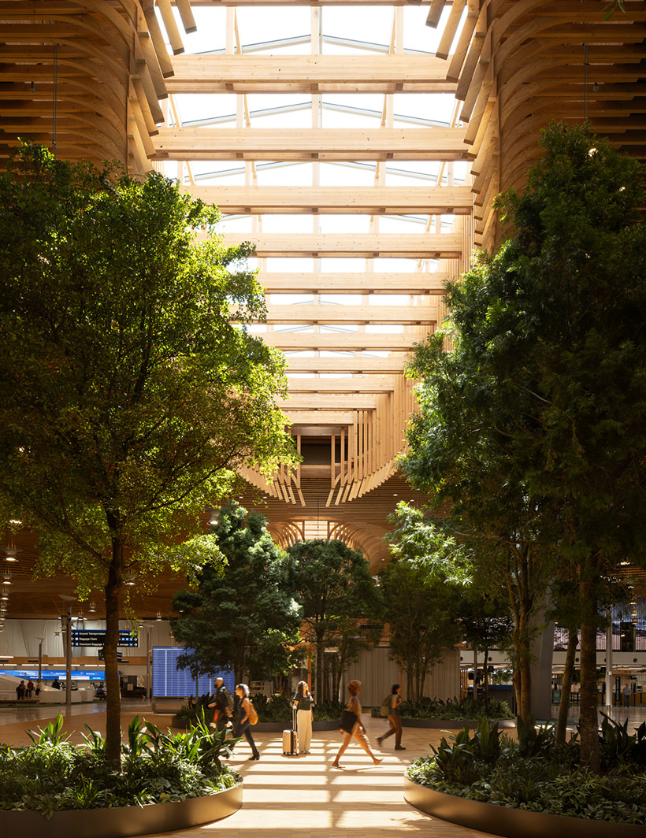
End-Focus: KPFF
Created by Wil Waring
KPFF provided structural engineering and physical security services for the project, which features a stunning 400,000-square-foot mass timber roof. The roof was fabricated with 3.3 million board feet of sustainably sourced wood, all procured within a 300-mile radius of the airport.
Image: KPFF, “Portland International Airport [PDX], Terminal Core Redevelopment”
Source: KPFF (Portland International Airport [PDX], Terminal Core Redevelopment): https://www.kpff.com/project/portland-international-airport-pdx-terminal-core-redevelopment/

Slide 7
End-Weight: Jacobs
Created by Wil Waring
As part of this transformation, Alexandra Hospital is redeveloping and expanding
[to enable [a more integrated model [of [health and care]]]].
[rel. v [det. adv. adj. n [p [n cc n]]]]
Source: Jacobs (Alexandra Hospital, Singapore): https://www.jacobs.com/projects/alexandra-hospital-singapore

Slide 8
Worksheet 1
Created by Wil Waring
~10 min

Slide 9
End-Focus & End-Weight
Created by Wil Waring
End-Focus
Definition: Given information tends to be listed first; new information is listed last.
(Also called the ”Information Flow Principle”)
End-Weight
Definition: “Heavier” elements tend towards the end of a sentence.

Slide 10
Fronting
(break the rules!)
Created by Wil Waring
Two main uses:
Extra/secondary emphasis
Compare/contrast

Slide 11
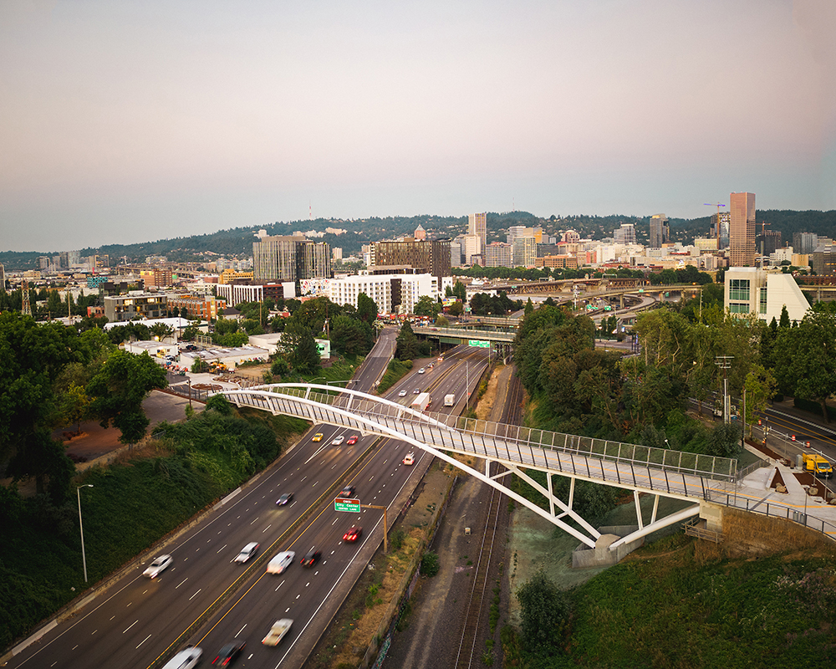
Example: KPFF
Created by Wil Waring
The span is also a key link in the City’s Green Loop that will eventually provide walking and cycling options around the central city and the Willamette River. Due to its highly-visible location, aesthetic design concepts and size, the Blumenauer Bridge is a signature structure for the City.
Image: KPFF, “Congressman Earl Blumenauer Bicycle and Pedestrian Bridge”
Source: KPFF (Congressman Earl Blumenauer Bicycle and Pedestrian Bridge): https://www.kpff.com/project/congressman-earl-blumenauer-bicycle-and-pedestrian-bridge-kpff/

Slide 12
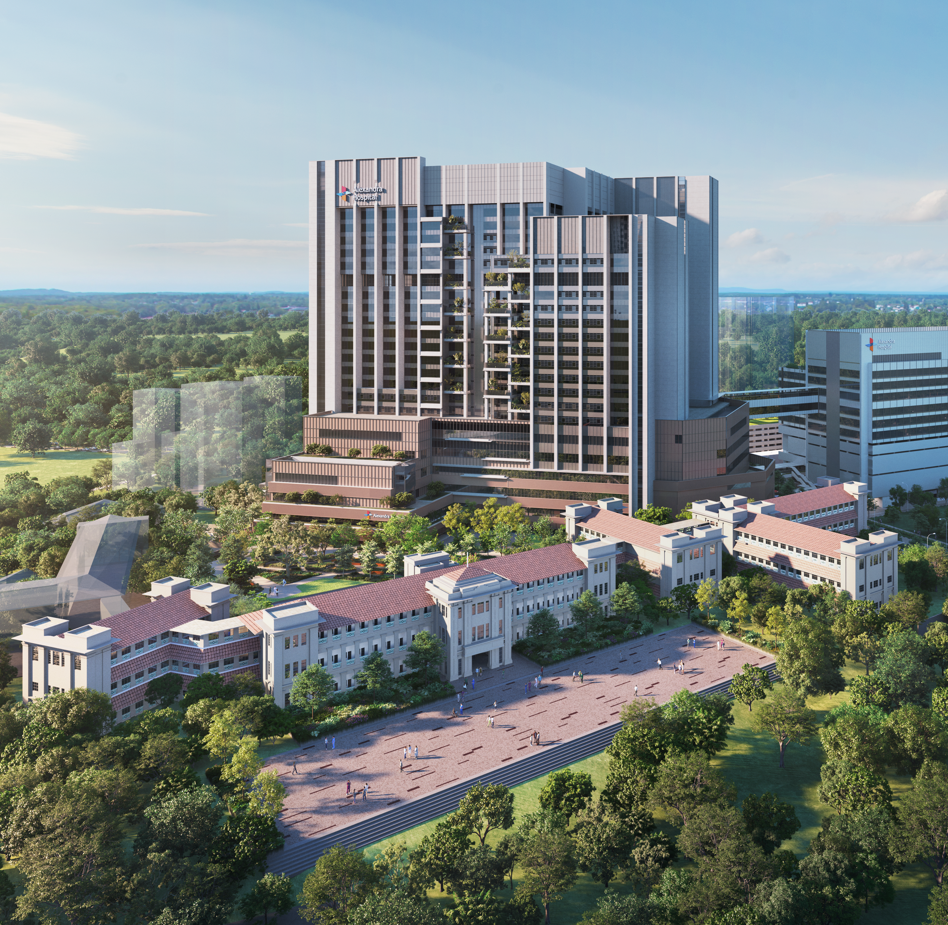
Example: Jacobs
Created by Wil Waring
Through robust appraisal systems, coupled with established standards and best practices, this approach enhances efficiency and productivity and fosters collaboration and integration amongst project stakeholders, building a solid foundation for success in meeting the project's rapid delivery timelines.
Image: Jacobs, “Alexandra Hospital, Singapore”
Source: Jacobs (Alexandra Hospital, Singapore): https://www.jacobs.com/projects/alexandra-hospital-singapore

Slide 13
Worksheet 2
Created by Wil Waring
~5-10 minutes

Slide 14
Questions?
Created by Wil Waring

Slide 15
Worksheet 3
Created by Wil Waring
15-20 minutes

Slide 16
Debrief
Created by Wil Waring

Slide 17
Thanks!
Created by Wil Waring
Do you have any questions?
wilwaring@pm.me
wilrwaring@gmail.com
Please keep this slide for attribution

